Slide 1



ThingWorx Industrial Innovation Platform
T.C
IOT Specialist
Year 2020

Slide 2
AGENDA
Introduction to PTC
Value proposition in IOT with ThingWorx
Augmented Reality
Feedback and Discussion
Next Steps

Slide 3
Ptc is uniquely positioned to help you succeed
$1Billion technology investment connects to the PHYSICAL world and enables new experiences
30 year heritage in the DIGITAL definition, software, and lifecycle management of things
Notes:
PTC is UNIQUELY POSITIONED to help you capitalize on the opportunity created by this physical and digital convergence
PTC is the only company with BOTH the capabilities and expertise in the Digital world of Things AND the capabilities and expertise in connecting to and experiencing the Physical world of Things
DIGITAL: Starting with our innovation around 3D parametric modeling 30 years ago, PTC has been at the leading edge of innovation around the digital definition, software, and lifecycle management of Things across our CAD, PLM, ALM and SLM solutions.
PHYSICAL: Over the past 3 years PTC has invested $700M in acquisitions and organic development of technology that connects to, analyzes the data from, creates applications for, and creates new experiences for the Physical world. This brings together decades of experience and best in class technology in IoT and AR.

Slide 4
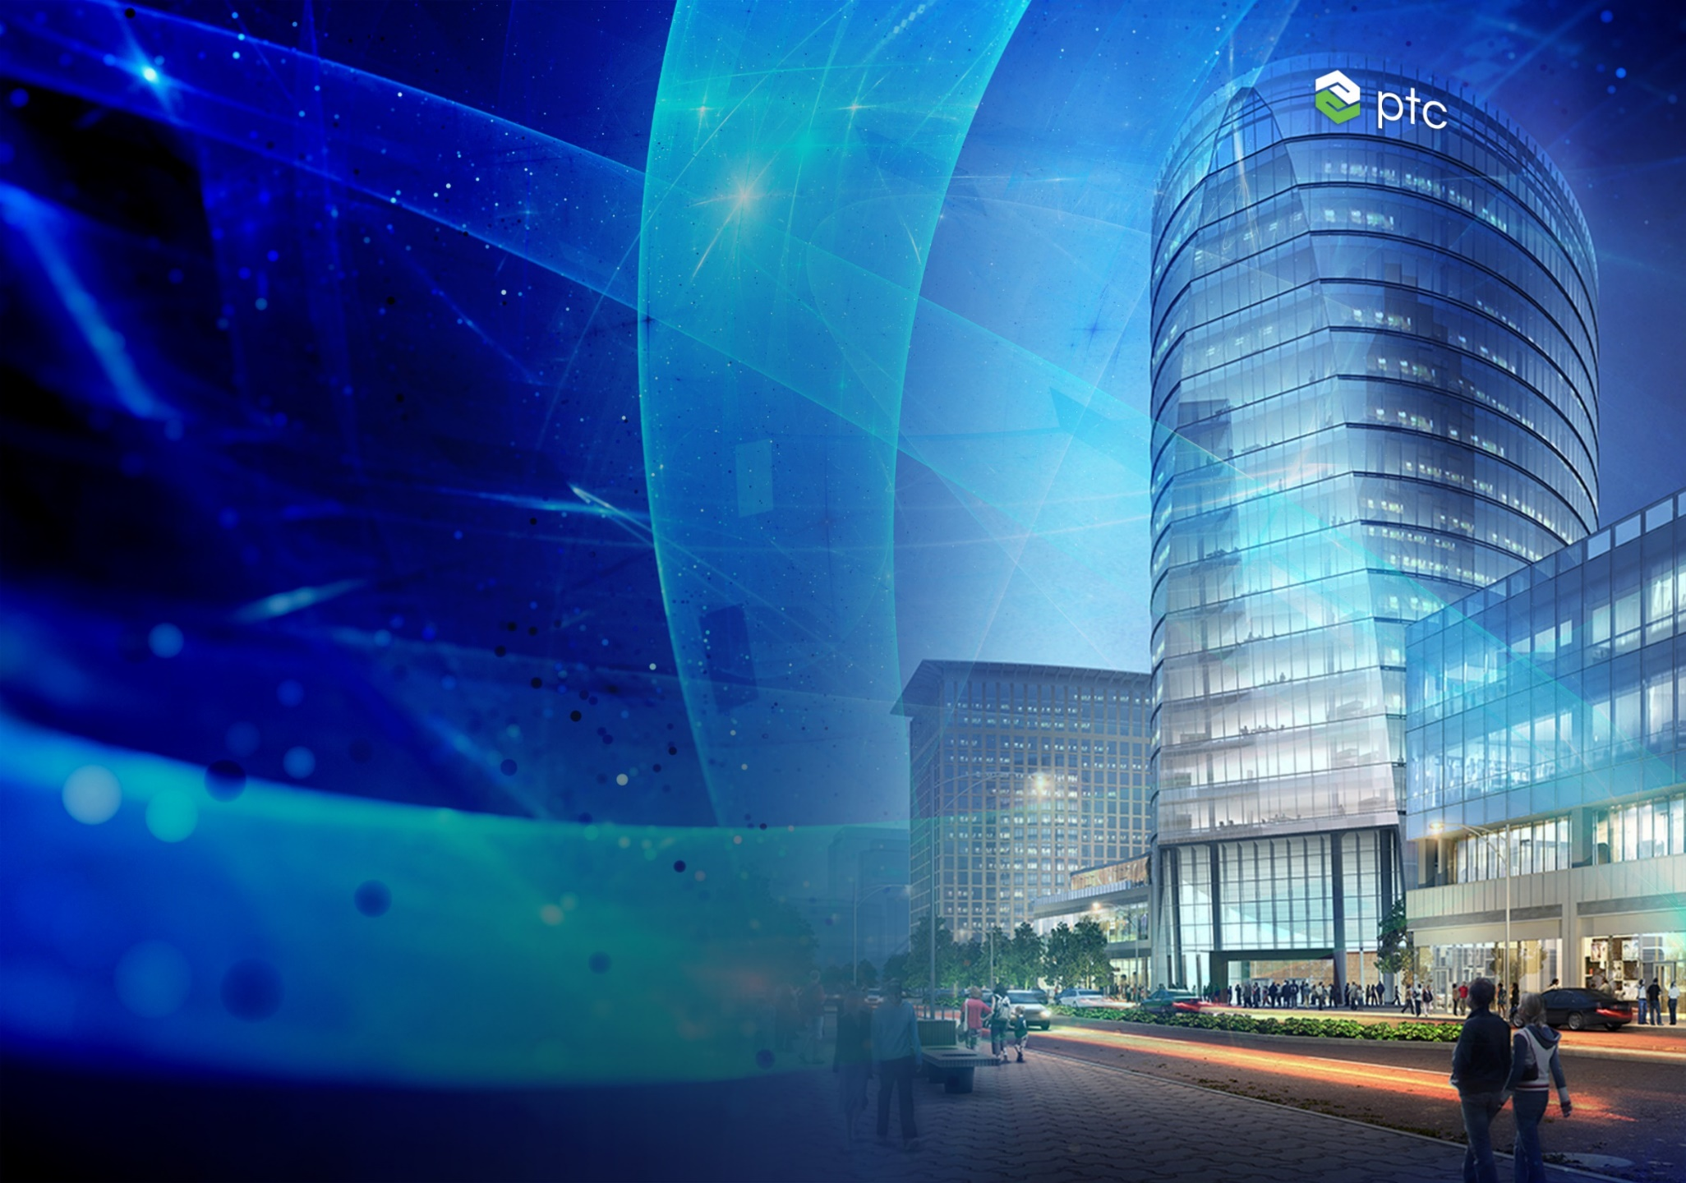


Who we are
Global Software Company, $1B+ Revenue
Focused on digital solutions
Leading Platform and Solutions Enable Industrial Innovation
Global Network of 550K+ Developers and 1K+ Partners
Strategic partners: Microsoft, ANSYS and Rockwell Automation

Slide 5
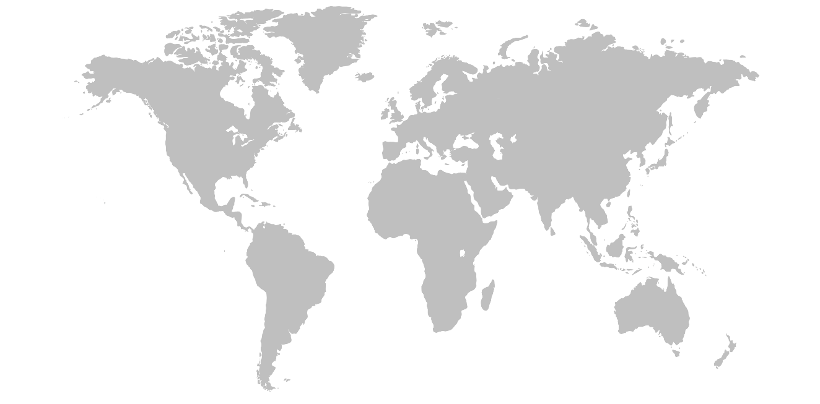
We are a Global technology company
REVENUE BY VERTICAL
REVENUE BY REGION
Other
9%
Life Sciences
5%
Retail & Consumer
9%
Europe 37%
Automotive
14%
Industrial Products
32%
Asia Pacific 20%
Americas 43%
Electronics & High Tech
15%
Federal, Aerospace & Defense
16%
FAST FACTS
$1.24B
FY 2018 total revenue
6K+ employees
1K+ partners
550K+ ecosystem developers
Notes:
This slide provides another way to introduce the company for those that don’t know us
Our customers are distributed across many verticals, across the globe, and we generate over a billion USD with 6K employees and our partner developer ecosystem.

Slide 6










Things are changing
Product
Smart
Product
Smart, Connected
Product
Product System
System Of Systems
TRACTORS
FARM EQUIPMENT SYSTEM
Farm Equipment System
TILLERS
PLANTERS
Farm Management System Platform
IRRIGATION SYSTEM
WEATHER DATA SYSTEM
COMBINE
HARVESTERS
SEED OPTIMIZATION SYSTEM
“The changing nature of products is disrupting value chains, forcing companies to rethink and retool nearly everything they do.”
Notes:
There is no doubt THINGS ARE CHANGING in a BIG WAY
The Things we CREATE, OPERATE, DEPEND on, even ENTERTAIN ourselves with are all evolving from relatively simply PHYSICAL objects to include complex PHYSICAL/DIGITAL SYSTEMS
Discrete Phases along the way of PHYSICAL, SMART, CONNECTED, PRODUCT SYSTEMS, and SYSTEMs of SYSTEMS
EVERYTHING is headed down same EXCITING but slippery slope
Everything from your WATCH to your CAR to your HOME to your FACTORY to your CITY INFRASTRUCTURE is headed this way
Completely changes ENGINEERING , MANUFACTURING, OPERATIONS, SERVICE, even SALES & MARKETING processes
Represents an OPPORTUNITY, a THREAT, and a CHALLENGE – all at the same time

Slide 7


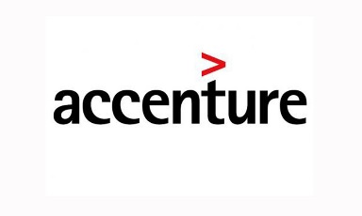

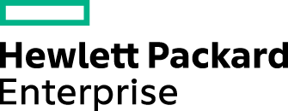











unique portfolio to enable Industrial Innovation
PARTNER SOLUTIONS
INDUSTRIAL INNOVATION PLATFORM
E2E PRODUCT LIFECYCLE MANAGEMENT
CLOUD | HYBRID | ON-PREM
Notes:
This visionary thinking has also informed our technology portfolio, and PTC has developed a unique and best in class portfolio of technology to enable this industrial innovation.
Starting with Product Lifecycle Management, PTC 30 years of experience and process expertise around our best in class Product Lifecycle Management technology including CAD, PLM, ALM, SLM.
Next, our Industrial Innovation Platform is the fastest way for industrial companies to unlock value at the new frontier of innovation, ThingWorx provides industry with new ways to conceive products, optimize operations, and disrupt established industries.
We want customers to realize value quickly so PTC leveraged its process expertise and built “Accelerator Apps” for the most common use cases. For example:
To better share Engineering data – ThingWorx Navigate
To improve manufacturing and operations processes – ThingWorx Asset advisor, controls advisor and production advisor
To rapidly develop Augmented Reality experiences – ThingWorx Studio
Partner Solutions: In addition to PTC apps, we have an extraordinary partner ecosystems that builds on top of PTCs best in class technology to create their own specialized apps and custom offerings
Finally, when it comes to deployment options we like to give customers choices – our platform Open system – capable of running in any cloud, on premise, or a hybrid model

Slide 8


NEW REALITY: integrating digital and physical worlds
INTERNET
OF
THINGS
Digital & Physical Worlds Combined
8

Slide 9

Need resized image
PHYSICAL THING/ENVIRONMENT
IoT
Fundamentally the PHYSICAL and DIGITAL worlds have converged
Additive Mfg
AR/VR
DIGITAL TWIN
Digital Thread
Notes:
Fundamentally what IS HAPPENING is that the PHYSICAL and DIGITAL worlds - which we have always compartmentalized into SEPARATE REALITIES…
Are now CONVERGING into a single NEW REALITY, THINGS will never by the SAME
This NEW REALITY creates so many NEW POSSIBILITIES - so many NEW OPPORTUNITIES for INNOVATION
So much VALUE can be CREATED or UNLOCKED
But this is not a fixed reality – it is CLEAR to me is that notion of PHYSICAL/DIGITAL convergence will continue to EVOLVE…

Slide 10
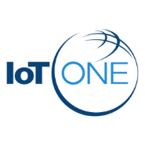

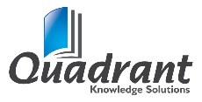



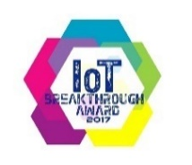

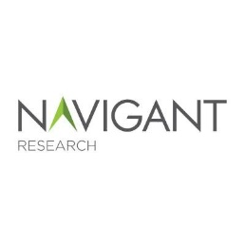
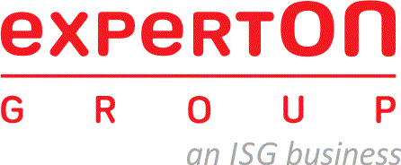



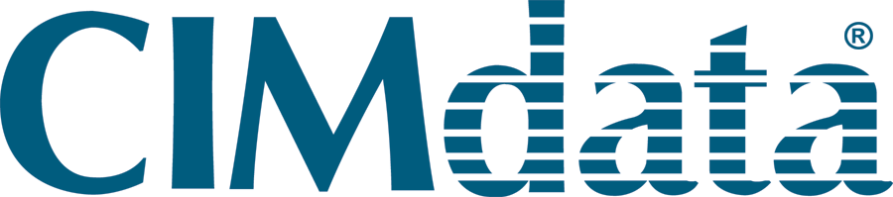


Industry Awards & recognition
2018
MAY
JUN
JUL
JUL
JUL
JUL
AUG
Industrial IoT Platform Visionary
2018 Leader in the Global IoT Platform Market
Best Industrial IoT Platform of 2018
Industrial IoT Software Platforms
Leading IoT Platform Vendor
Best Industrial IoT Platform of 2018
Top Smart Manufacturing Platform
2017
JAN
JAN
JUN
JUL
AUG
NOV
NOV
DEC
IoT Company of the Year
Industrial IoT Company of the Year
IoT Innovative Product of the Year Vendor
IoT Platform
Market Leader
Boston Globe Top Places to Work
Leading IoT Platform
IoT Platform Leader
Best IoT Platform CODiE™ Award
PLM Leader
2016
JAN
JAN
JUL
SEP
SEP
OCT
NOV
Technology Leader in the Global IoT PLM Market
Leading Provider of PLM in Aerospace and Defense
IoT Enablement Company of the Year
Leading Augmented Reality Vendor
IoT Software Platforms Leader
IoT Innovation Vendor of the Year
IoT Application Enablement Platforms Market Share Leader
Technology Innovation Award for IoT

Slide 11
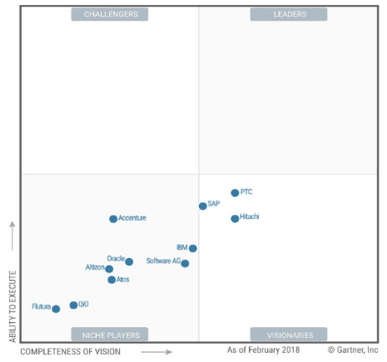
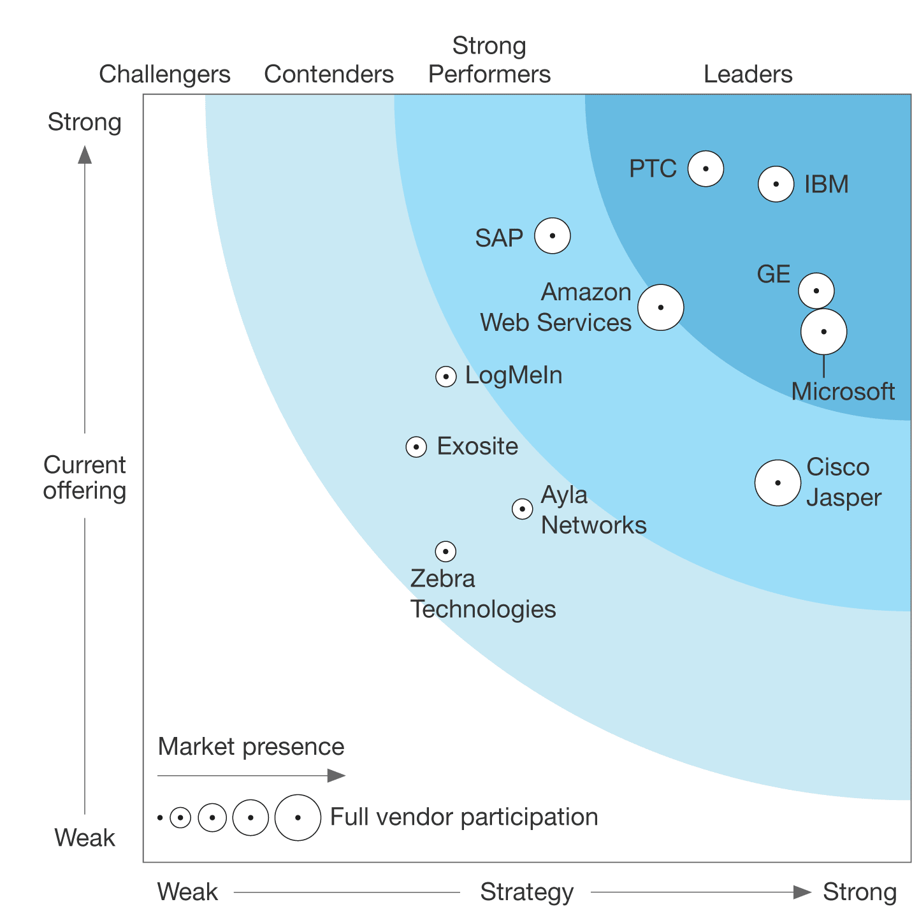
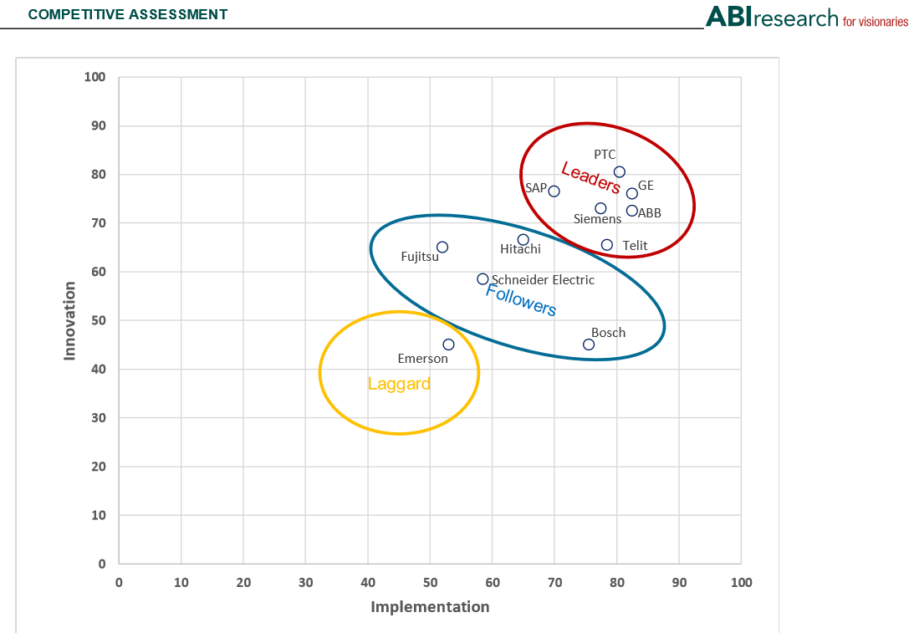
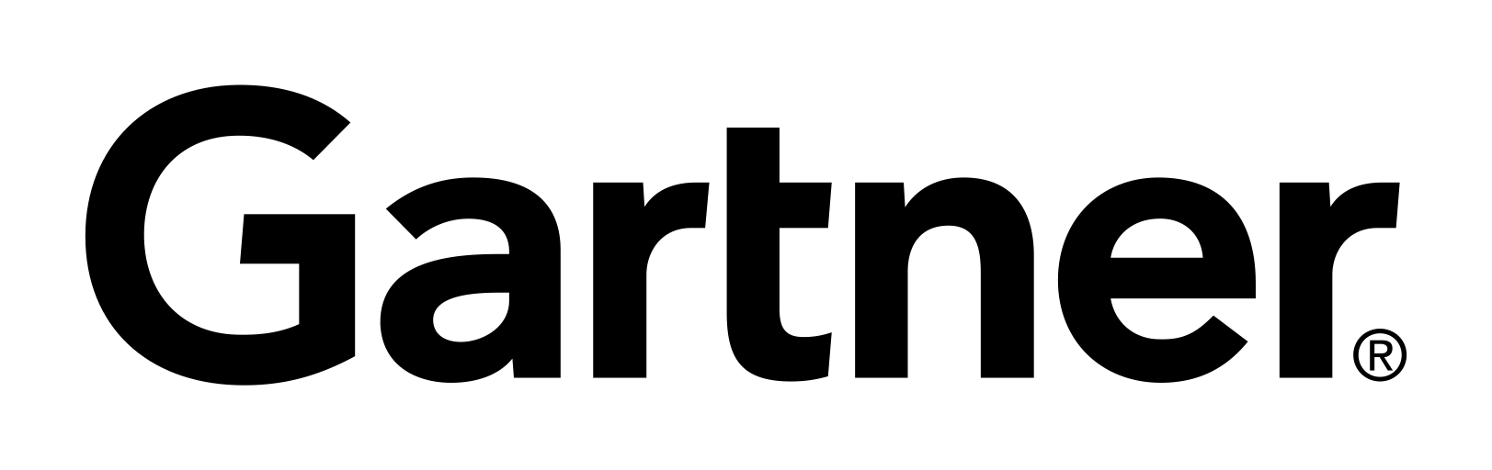


Industry Analysts Endorse PTC’s IOT Leadership
Industrial IoT Platforms
Magic Quadrant
IoT Software Platforms
Smart Manufacturing Platforms
% of Apple and Android AR Apps
Other
10%
VUFORIA 81%
ABI Research
Aeon Mobile
– Justin Hester, Senior Researcher, Hirotec

Slide 12
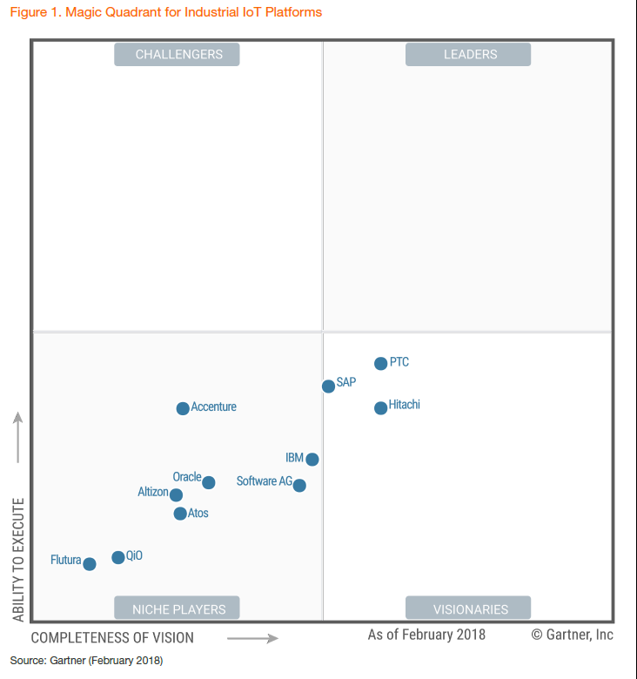
PTC earns top position in the first Gartner Magic Quadrant for IIoT Platforms.

Slide 13
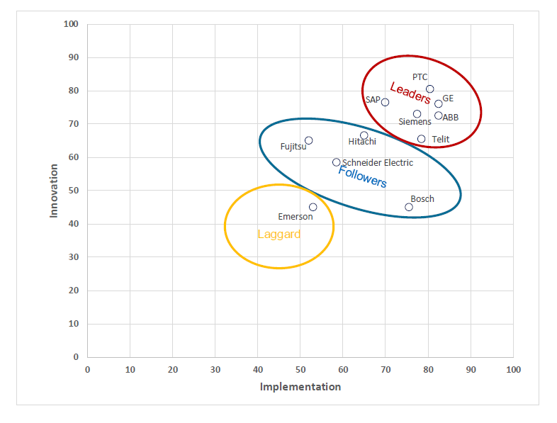
ThingWorx is ranked as the top smart manufacturing platform
Source: 2018 ABI Research Smart Manufacturing Platforms Assessment

Slide 14












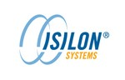




















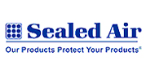

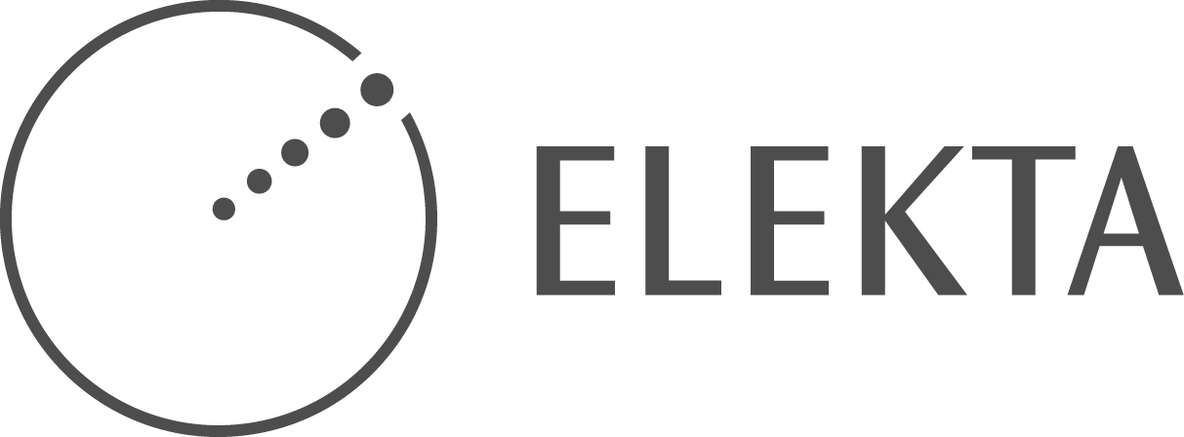







Breadth of Platform Customers
Electronics & High Tech
Transportation
Industrial
Commercial Equipment
Life Sciences
Medical Devices
Notes:
PTC’s customers include some of the most recognized brands across industries

Slide 15
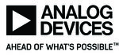




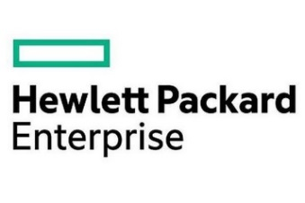

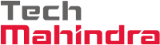
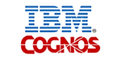
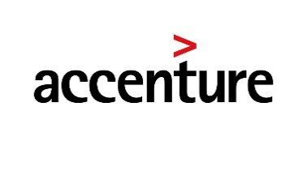

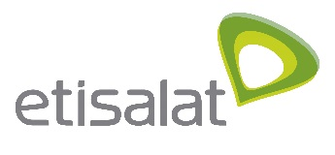




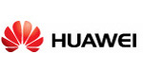






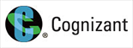

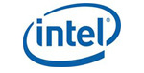





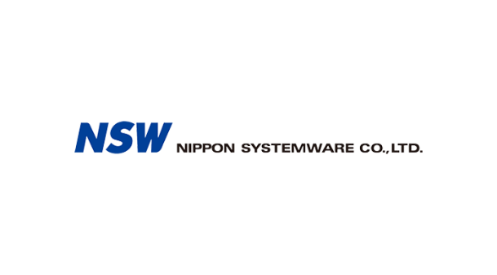


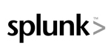
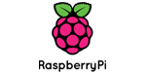
Breadth of our partner ecosystem
Edge Communication & Embedded Devices
Communication Service Providers
System Integrators & VARs
Business Systems & Analytics
Solution Providers
Notes:
Given all the change in the way things are created and all the value and even disruption that can be created by the Internet of Things, companies are looking for help with their transformation to remain relevant and competitive in this new world.
PTC can help them. We are a provider both of next-generation technology platforms, vertical enterprise applications for the manufacturing industry, and have assembled a vibrant ecosystem of developers and partners.

Slide 16
Value proposition in iot with thingworx
2

Slide 17
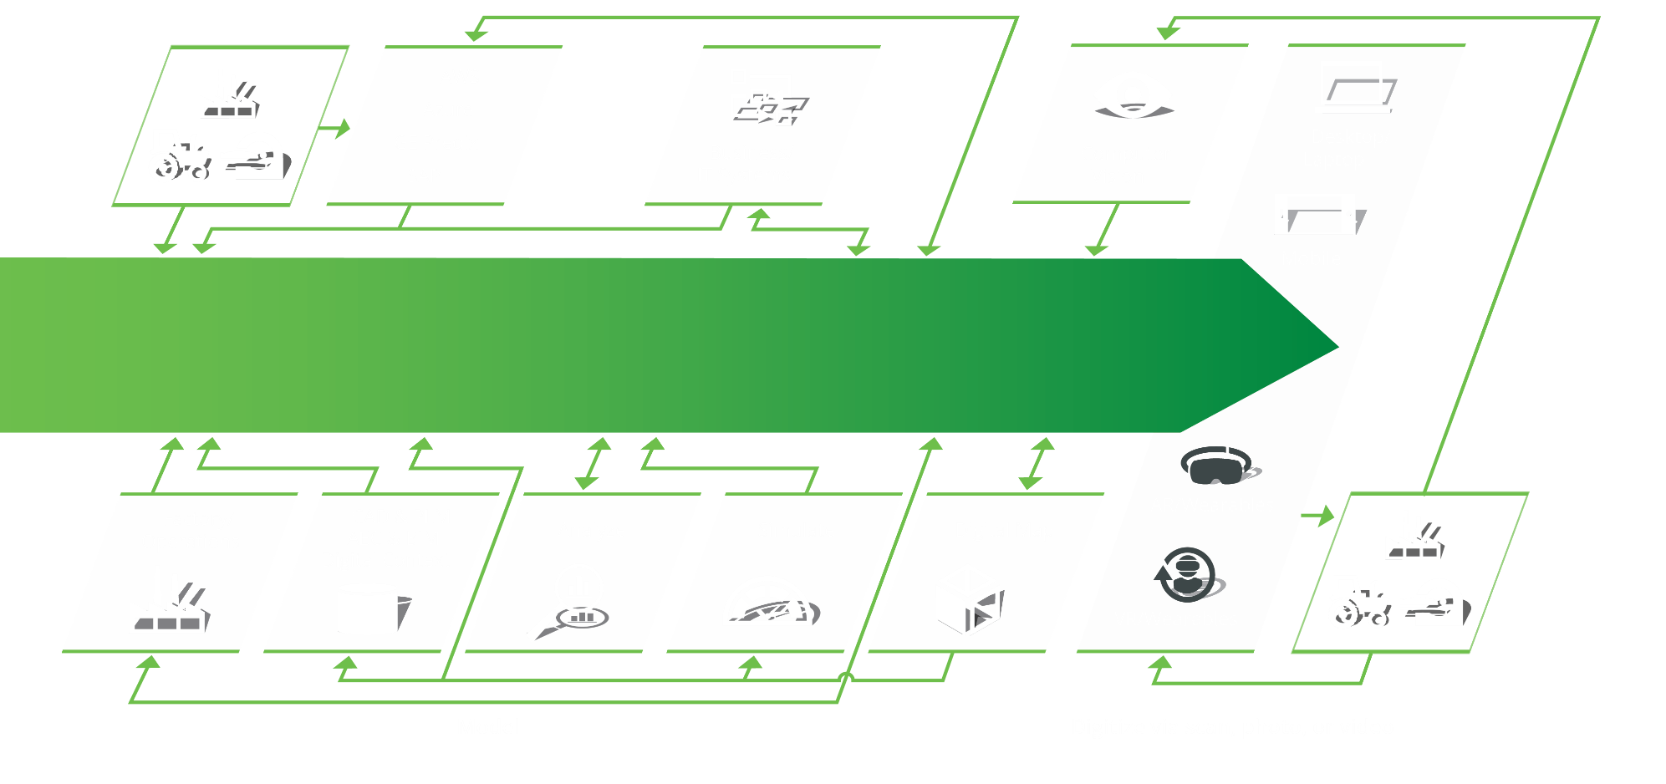
Industrial innovation platform capabilities
SOURCE
CONTEXTUALIZE
SYNTHESIZE
ORCHESTRATE
ENGAGE
Notes:
Source – Incorporate and aggregate data from anywhere – directly from sensored products and systems, from PLCs, IoT gateways on the factory floor, from existing product clouds, from your 3D design and engineering systems, and from other business systems like CRM, ERP and PLM.
Contextualize – Structure the data in a way that makes sense - organize digital data from your physical systems and products, and enrich it with additional data, like 3D geometry, essentially creating a digital twin
Synthesize – Gain valuable insight – analyze, simulate and predict physical product and system behaviors and performance using included analytics capabilities or third party tools.
Orchestrate – Drive action and results in physical and digital systems - automate processes that connect business systems data, products and physical operations.
Engage – Enable people to better perform and make decisions – clearly present relevant, compelling information on desktop, web & mobile apps – as well as cutting-edge augmented reality experiences
Architecture, Engineering and Construction (AEC)
Building Information Modeling (BIM)
Building Information Management (BIM)

Slide 18



PTC thingworx INDUSTRIAL IOT PLATFORM
Applications
ThingWorx Utilities
ThingWorx Apps
Engineering
Manufacturing & Supply Chain
Services
ThingWorx
Analytics
ThingWorx Foundation
Thingworx Augmented Reality
Enablement Services
Watcher
Composer
Mashup Builder
REST API
Studio
Predictor
Platform Services
Security
Logic
Storage
View
Optimizer
Communication Services
EMS
SDKs
KepServerEX
Extensions
Experience
Systems
Assets
People
ERP
Web
Vendor
ERP
MES
SCADA
Fleet
Line
Tank
Robot
Plant
Office
HQ

Slide 19
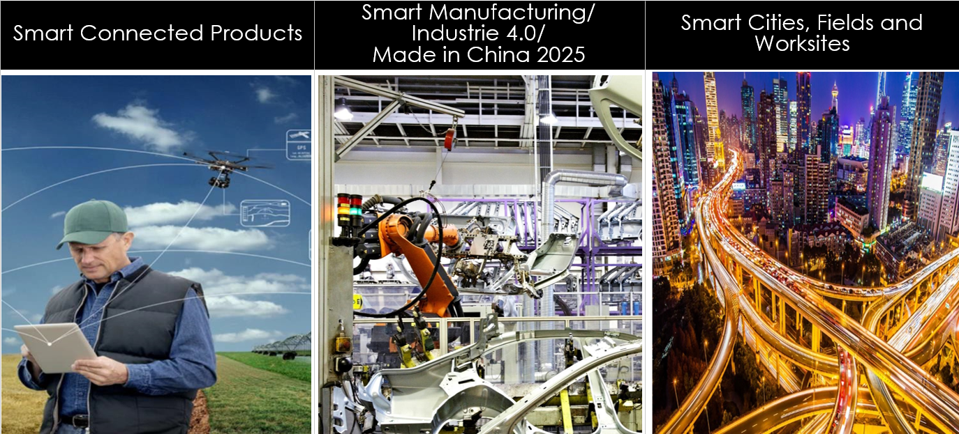
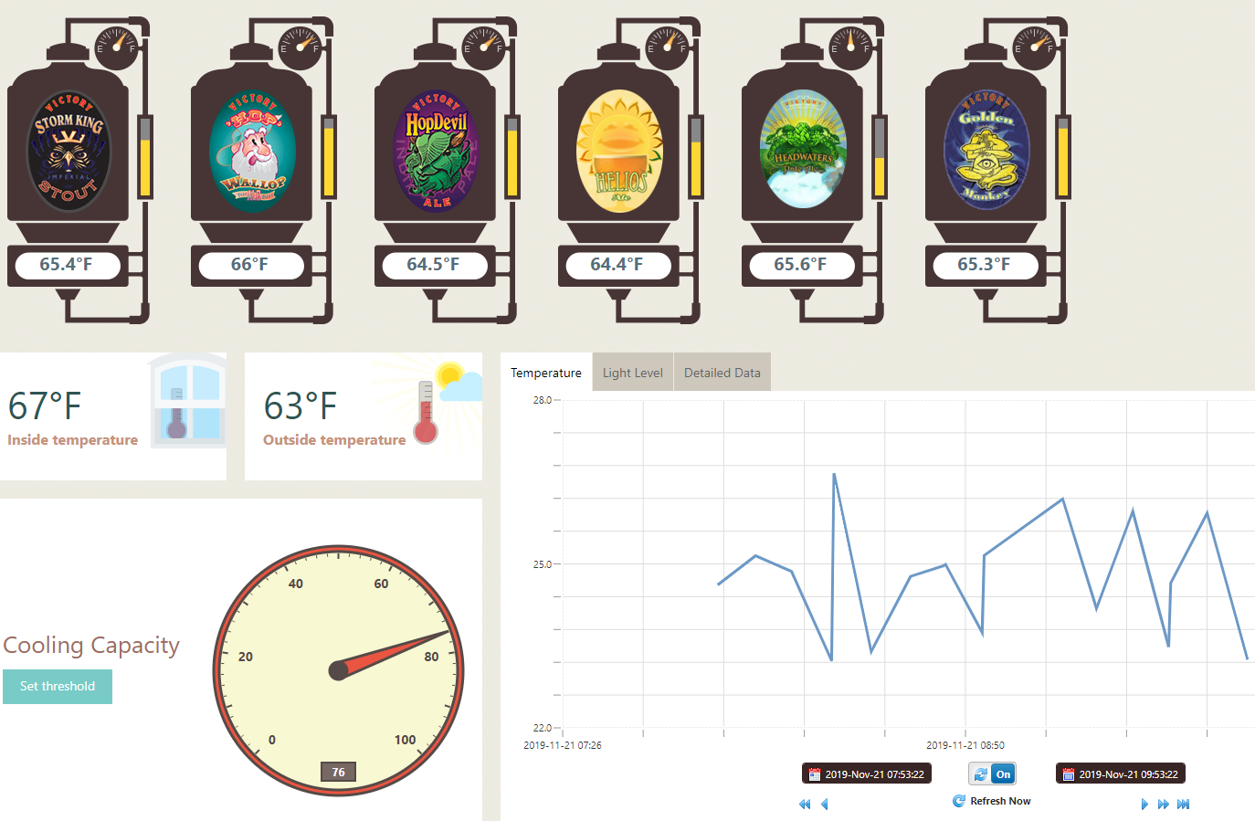
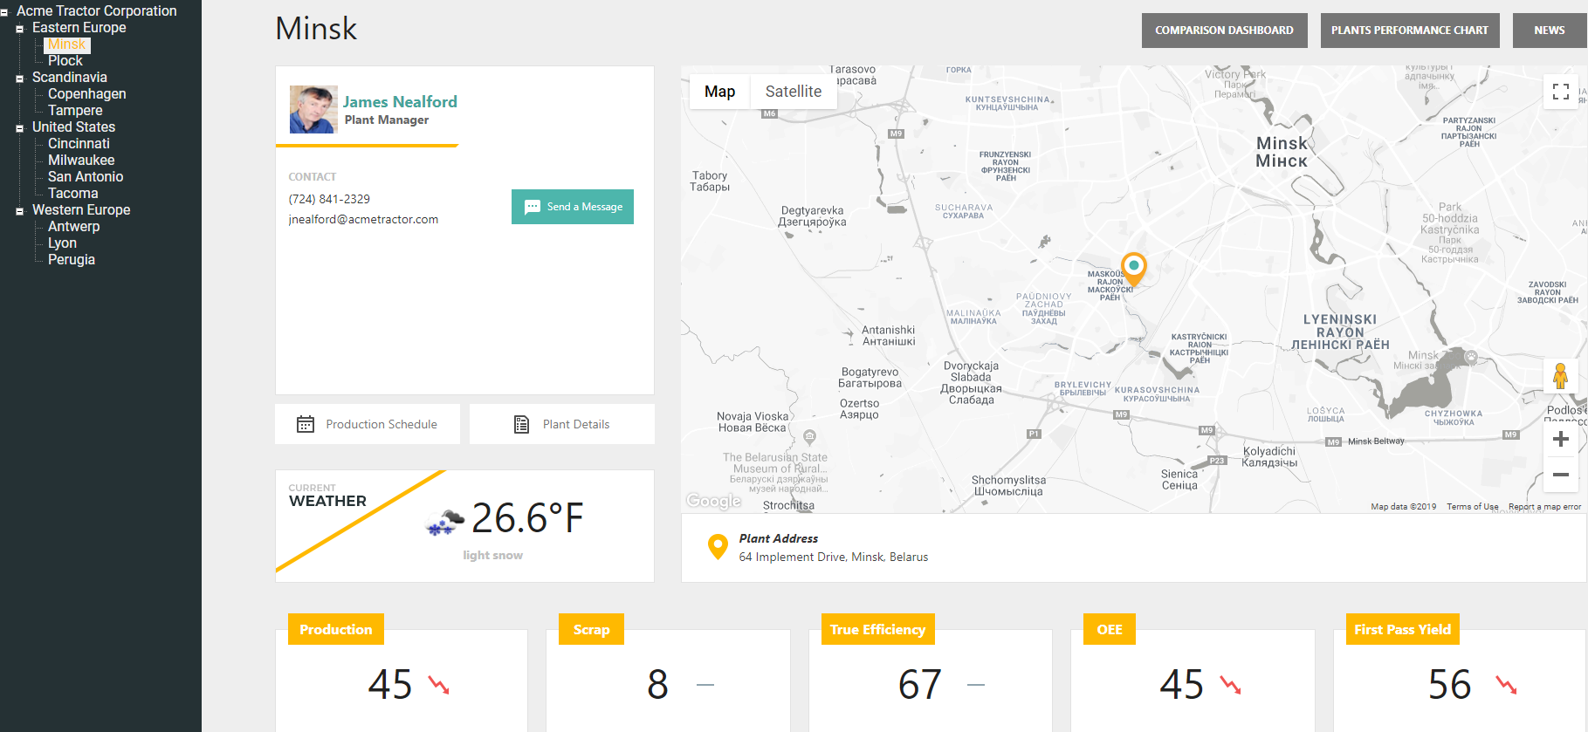
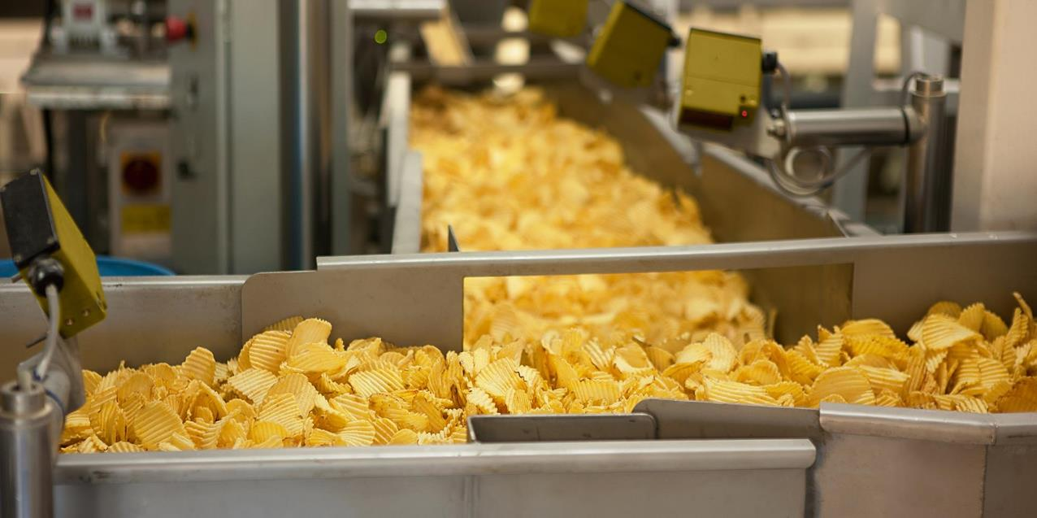
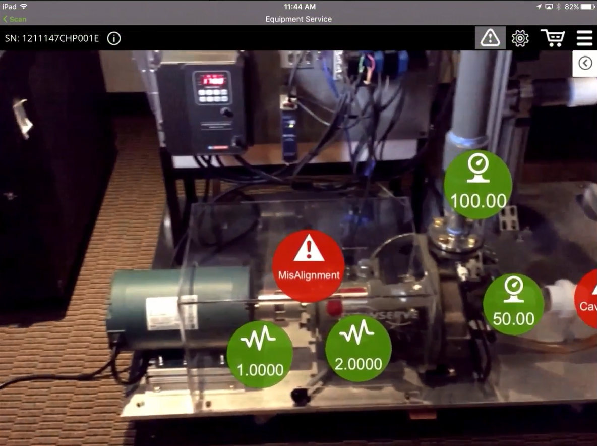
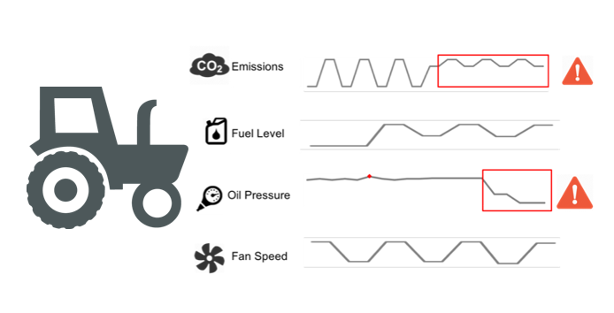
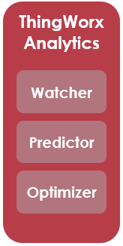
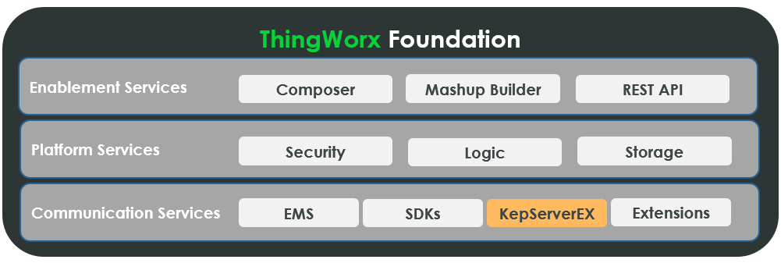
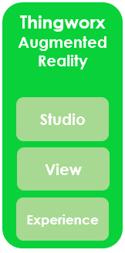
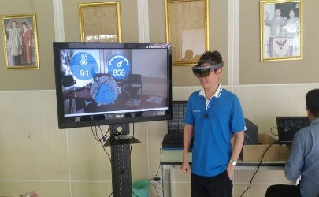
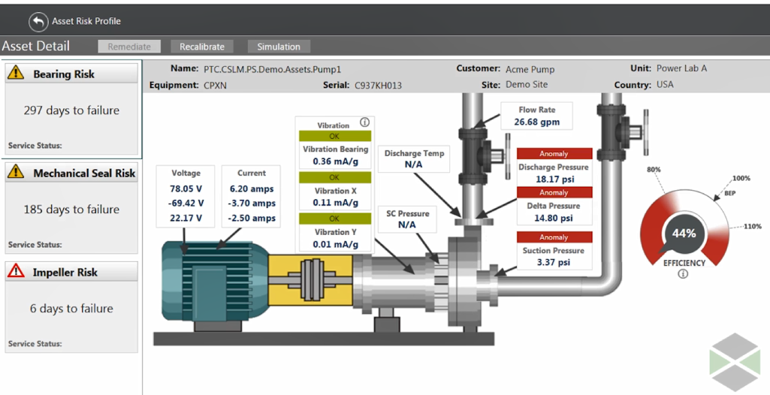
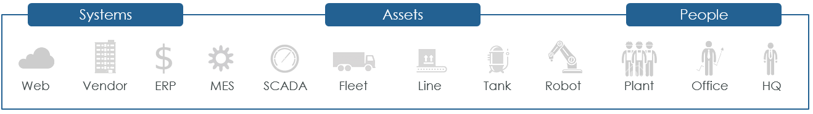
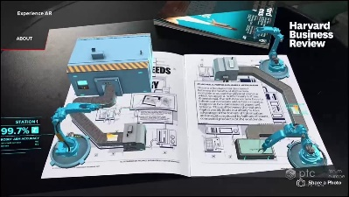




PTC thingworx INDUSTRIAL IOT PLATFORM
PLC
Embedded System
Gateway

Slide 20
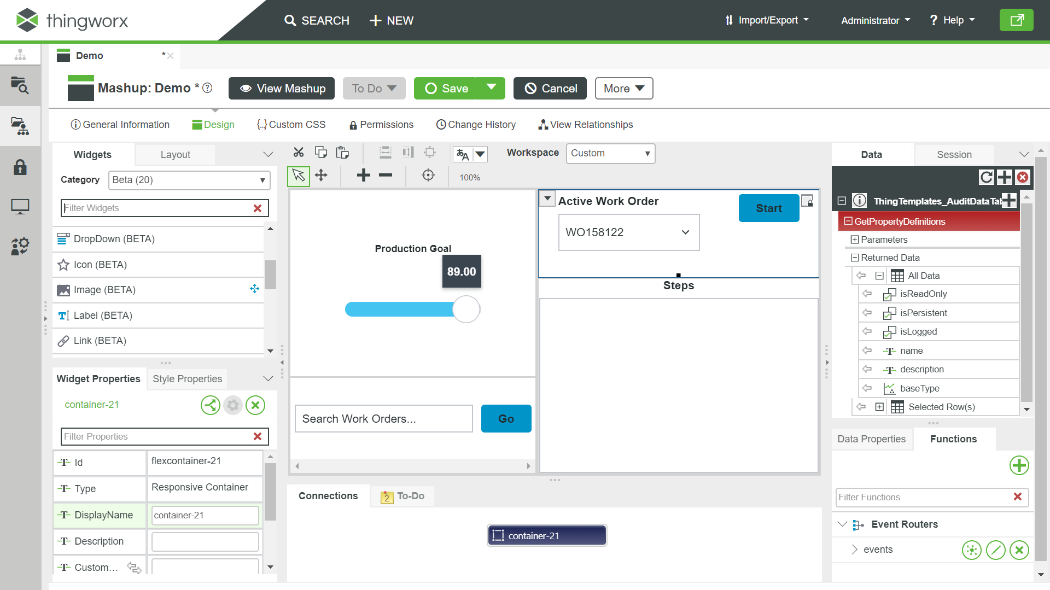
Thingworx Mashup builder
Mashups are the fastest way to build IIoT solutions
Mashups allow you to see and interact with your Things
The Mashup Builder is the WYSIWYG developer tool for creating content
Widgets
Data + Services
Canvas
Properties
Functions
Connections
Notes:
Chris

Slide 21
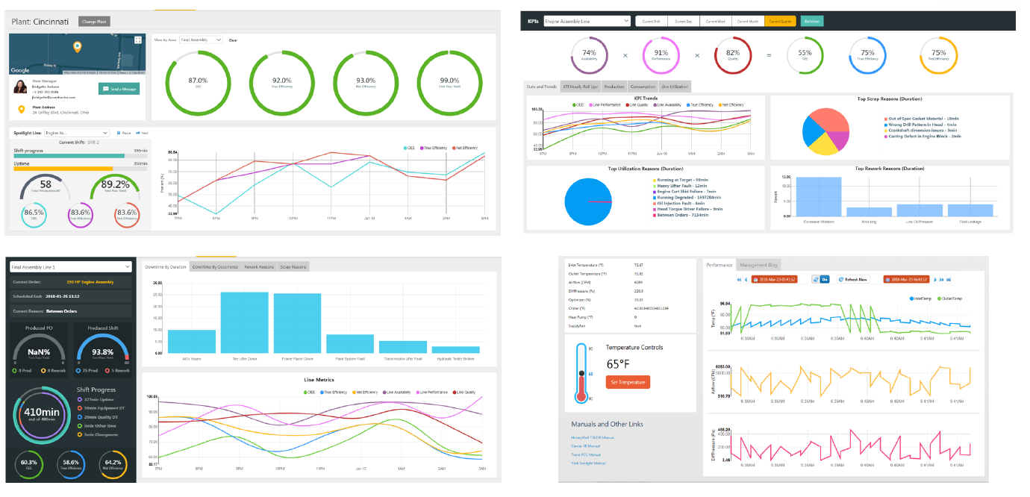
PTC thingworx for Intelligent Monitoring

Slide 22
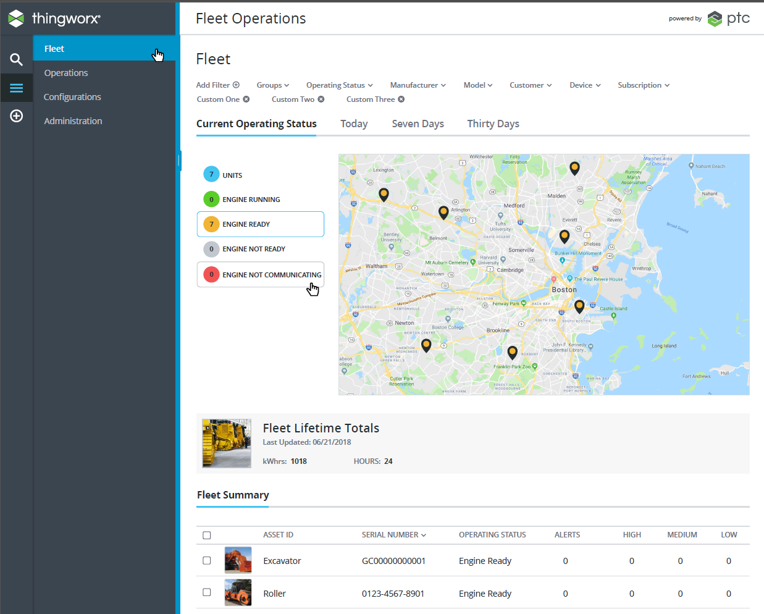
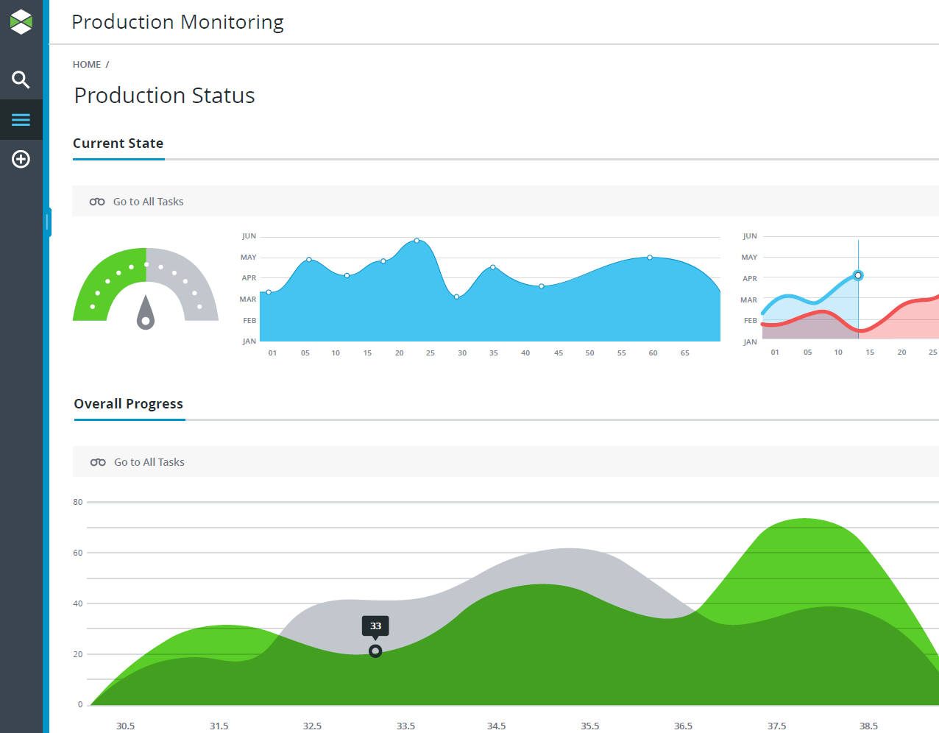
Mashup 2.0 and ptc design system
PTC Design system is encoded within the Mashup Builder

Slide 23
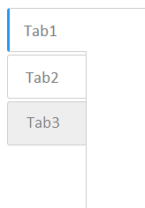













widgets
65+ out-of-the box widgets
Newer widgets based on modern polymer web components
Drag and drop on canvas to quickly create powerful IIOT solutions

Slide 24

Responsive layout advanced
Responsive layout editor, based on Flex
Ability to set orientation, justification, distribution, alignment, stretching, wrapping, growing and shrinking rules
Content lays out according to rules, adapts to the screen size and settings

Slide 25

ThingWorx Analytics for Predictive Maintenance

Slide 26

ThingWorx applications

Slide 27

Complete iot platform capabilities
Notes:
To summarize and conclude:
PTC is UNIQUELY POSITIONED to help you capitalize on the opportunity created by this physical and digital convergence by providing BOTH Solutions and a Platform, that extend and multiply the value of each.
This provides customers with BOTH complete Solutions & a Platform to build your own
This broad set of capabilities enables developers and solution builders to connect their devices, analyze them, implement applications and user interfaces, manage and remotely control devices, and deliver new types of experiences through technologies like augmented reality. All on a secure and scalable architecture.
No other platform in the market provides this many integrated capabilities in one place – making solution development quick, and time-to-market faster.
Solutions built on ThingWorx help enterprises make money, save money and reduce risk all from one, integrated platform.

Slide 28

Example Plant Performance Metrics

Slide 29


ThingWorx Platform
ThingWorx Foundation
Enablement Services
Composer
Mashup Builder
REST API
Drag and Drop” Mashup Builder empowers developers and business users to rapidly create rich, interactive applications.
User can access to the developed ThingWorx application through Computer or Mobile Devices
Notes:
New in 8.3
A variety of pre-built calculations and other transformations useful in both general IoT application development and as a preparation step in changing raw data into something useful for predictive analytics training and scoring.
The calculation and transform services are augmented by statistical monitoring calculations commonly used in manufacturing and other applications to monitor data and determine if it stays in statistical control

Slide 30


PTC Service Parts Management
CAPABILITIES
Optimizes inventory globally across stocking locations
Mitigates excess and shortage conditions
Forecasts parts demand
Analyzes simulation/KPI analysis to measure and tune the model
Time Phased Order Planning
Demand Forecasting
BENEFITS
Increase Equipment Availability
Reduce Excess Inventory
Increase Part Availability
Improve Service Levels
Notes:
Capability Highlights
Transactional software change management to ensure consistent updates of configurations, reducing the chances of broken builds
Automate the release of software build to product bill-of-materials
Immutable baselines of software configurations

Slide 31
Analytics Maturity model
VALUE
PRESCRIPTIVE
ANALITYCS
HOW CAN WE MAKE IT BETTER?
PREDICTIVE
ANALITYCS
WHAT WILL HAPPEN?
EXPLANATORY
ANALITYCS
Thingworx Advanced Analytics
WHY DID IT HAPPEN?
DESCRIPTIVE ANALITYCS
WHAT HAPPENED?
ThingWorx Foundation (Standard)
COMPLEXITY

Slide 32




















Connect anything
IoT Cloud
IoT
protocols
MQTT REST
Azure IoT
Connector
Protocol Adapter kit
AWS IoT
Connector
GE Predix
Ext & Agent
Smart Devices
Industrial Data Sources
Embedded System
API
IoT Gateway
ThingWorx
Edge SDKs
API
thing
API
Gateway
OPC UA
150+ Industrial Protocol
Drivers
Industrial
Equipment
REST API
model
API
API
PLC
API
JDBC
SQL Databases
MES
Historian
ThingWorx
Marketplace
Extensions SDK
Integration Connector
Web Services
Business Systems
ERP PLM SLM Analytics CRM Historian
SAP, Windchill
Enterprise Systems
Notes:
ThingWorx enables companies to securely connect to nearly any device using our SDKs, Edge MicroServer, or by leveraging standard and proprietary communication protocols. Devices can connect over any network via wired, wireless or cellular methods.
ThingWorx “AlwaysOn” connectivity, via ThingWorx SDKs and the Edge MicroServer, provides a scalable, secure, and easily deployable communication technology designed for continuous bi-directional connectivity between sensors, devices, equipment, and the ThingWorx server - regardless of the network architecture
ThingWorx and its Industrial Connectivity Module powered by Kepware each deliver data drivers to enable out-of-the-box connectivity with a wide variety of devices. There are over 150 protocols adapters to access real-time data from industrial equipment.
ThingWorx enables distributed, real-time edge computing capabilities with an edge ‘solution stack’ that collects and aggregates data from sensors, performs highly automated machine learning and executes business logic. Keeping the entire IoT computing operation onsite or close to the point of data acquisition can address potential latency, cost and security concerns associated with reliance on cloud only solutions.
Edge MicroServer
Prebuilt “agent” application that can “drop in and run” in a Windows or Linux environment
Can run on a gateway or be directly embedded into a device
Software Development Kits (SDK)
Software libraries that allow customers to create their own custom agent
Several platforms/programming languages available – Java, C, .NET, iOS
Can be deployed in gateways or devices

Slide 33













ThingWorx architecture
Azure
IoT Clouds
ThingWorx Composer
ThingWorx Mashup Builder
REST APIs
Model Definition
Analytics Definition
Desktop/Laptop
EMS - Edge MicroServer
ThingWorx Edge SDKs
Axeda connectors
Gateway
ThingWorx Analytics
Business Logic
Data Flow
Mobile
Vuforia Studio
ThingWorx connection Server
Persistence Providers
H2 (Embedded)
ThingWorx
Industrial
Connectivity
AR/Wearables
PostgreSQL
MS SQL
InfluxDB
Azure SQL
Controllers
Sensors
Historians
Edge/OT Environments
ThingWorx Flow
Integration
Connectors
ThingWorx
Marketplace
VR/Wearables
JDBC Connector
CAD & PLM
AEC & BIM
Digital Context
Database infrastructure (On premise or Cloud)
Business/IT Systems
Secure Data Flow
Notes:
Notes:
Runtime is important
Persistence provider is boring and can be shorten
ThingWorx analytics
Analytics server
Move details and put up a foundation specific version
ThingWorx studio
Mashup builder is not actually used to create mobile apps (A dotted line)
We have customers that build apps that give it to their customers.
Model tags (tag configuration) inside the thingworx core which is used for industrial connectivity.
Ability to write services to map to end points- Salesforce SAP Windchill (app key involved)
Base type connector- Generic connector, Swagger connector, Windchill connector,
Connect it to the URL of windchil/SAP and once connected, we can create a route services. We can create mapping in composer of Windchil data.
Ryan Orwoll- Studio
Ken Rawlings Feedback-
Additional Extensions
Navigate integration systems
Business/IT systems

Slide 34












ThingWorx flow – Deployment configurations
User 1
User 2
Public Cloud
PTC Azure Cloud
User 2 Cloud flows
User 1 Cloud flows
On-prem firewall
On-prem firewall
Entirely on-prem deployment
Web Socket
Web Socket
On-prem User
ThingWorx Flow
ThingWorx Federation Server
ThingWorx Federation Server
ThingWorx Flow
Forward looking information subject to change without notice

Slide 35


Reference architecture – high Availability (HA)
High Availability System (HA)
Multiple Connection Servers as needed
Load balancers to direct to active platform
Active/Passive model for ThingWorx Platform HA
ZooKeeper to manage leader election
File Server with ThingWorx Repository
HA requirements for chosen data providers
PostgreSQL using pgpool II and multiple nodes

Slide 36






Current
ISA-95
L4/L5
Business Systems (ERP, SCM, PLM) Governance & planning
Disparate equipment & data
Unique structures of data
Production sensitive networks
Rigid systems - costly to evolve
Rip and Replace Innovation
L3
Production Execution
(MES / MOM)
L2
Process Monitoring
(HMI-SCADA)
L1
Process Sensing, Manipulating
(PLC)
%
LOGISTICS
SUPPLIERS
ENVIRONMENTAL
IOT GATEWAY

Slide 37

“DIGITAL” INDUSTRIAL INNOVATION PLATFORM
Current
Industrial Innovation Platform
ISA-95
L4/L5
Business Systems (ERP, SCM, PLM) Governance & planning
Innovation Platform
PLANT & CORP.
MANAGEMENT
MAINTENANCE
QUALITY
OPERATORS
L3
Engage
Production Execution
(MES / MOM)
Connected
Real-time
Role-based
Predictive / Prescriptive
Mobile & augmented
Wrap and extend Innovation
Orchestrate
Break-Thru Solutions
L2
Synthesize
Process Monitoring
(HMI-SCADA)
Contextualize
L1
Process Sensing, Manipulating
(PLC)
Source
%
LOGISTICS
SUPPLIERS
ENVIRONMENTAL
IOT GATEWAY

Slide 38


ThingWorx Solutions Span Technology layers
Traditional System Landscape
ThingWorx complements and brings
Level
4
Business Systems (ERP, CAD, PLM)
Unified visibility across systems, assets, devices and people
Wrap and extend existing systems
Actionable and comprehensive operational intelligence
Real-time, social, mobile
Rapid application development
Level
3
Operational Control
(MES, MOM)
Level
2
Process Monitoring
(HMI, SCADA, Test Stands)
Level
1,0
Control Level & Data Acquisition (PLC, CNC, Autoclave)
Site 1
Site 2
Site n
External
Logistics
Suppliers

Slide 39


Slide 40

ThingWorx extending existing investments
Typical Landscape
Extended with ThingWorx
Notes:
ThingWorx spans existing software investments and enables the creation of a Service Oriented Architecture (SOA). It is important to note that a standards-based services layer is not the same as standardization of technology. Software technology harmonization programs are not the same as standards-based services layer vision. Software technology harmonization may result in a common commercial solution being selected for the enterprise. For most enterprises, these standardization of technology initiatives are cost-prohibitive and impractical. A standards-based services layer means that work processes spanning multiple systems are modeled as independent services for consumption in composite applications as needed. A rip-and-replace strategy is too expensive and is not necessary to achieve smart, connected operations.

Slide 41






























DASHBOARDS
ANALYTICS
PREDICTIVE…
MES/ERP
CORP
HQ
ENTERPRISE
DATABASES
ODBC
OPC UA
BIG DATA
REMOTE
SITES
DATABASES &
HISTORIANS
CLOUD
HMI
SCADA
REDUNDANCY
PANELS
IoT
OPC
CLIENT
DEV
OPC UA
OPC DA
OPC UA
OPC DA
OPC HDA
OPC DA
ODBC
IDF Splunk
Native Drivers
PLC/DCS/RTU
AlwaysOn
REST/MQTT
150+ Drivers
OPC DA Client Driver
Drivers
BAC/net Driver
Specialty Drivers
IT DEVICES
SNMP
PLC
UCON/CID Driver
HVAC
3rd PARTY
OPC
Robots, Pickers, etc.
Weigh Scales
RFID, Barcode, etc.
Building Management
Valves, Mixers, CNC, Pumps, etc.
Sensors
Motors
Meters
Notes:
Kepware Diagram

Slide 42














Thingworx Connectivity to data sources
Extensions (prebuilt or custom). E.g. MQTT, TCP/IP, twitter, Twilio and many more.
KEPWARE
Device Clouds
AWS IoT
Azure IoT Hub
Build-Your-Own
ThingWorx Edge SDK’s
Build robust, secure, full-featured edge integrations and gateways for any platform.
ThingWorx Edge MicroServer
Pre-built IoT Gateway for easily connecting your Windows, Linux, or Linux ARM devices and devices on local networks.
Lua Script Resource
Rapidly integrate data sources via simple Lua scripts.
ThingWorx REST API
Bring the power of the ThingWorx platform to even the smallest of devices.

Slide 43








ThingWorx Manufacturing Apps
Transform your performance by giving your operations teams unprecedented capabilities to see, understand and act in real time. ThingWorx manufacturing apps accelerate your time-to-value and offer unmatched flexibility.
ThingWorx Production Advisor
ThingWorx Asset Advisor
ThingWorx Controls Advisor
Plant Manager
Maintenance
Controls Engineer
Optimize Production Performance
Real-time monitoring of production status and critical KPI’s. Detect and react instantly to production schedule and quality issues.
Reduce unplanned downtime
Real-time monitoring of the status and health of critical production assets. Detect anomalies to identify potential issues that could result in unplanned downtime.
Ensure OT Network Data Quality
Unified real-time monitoring of all connected end points and related data elements on the OT system network. Rapidly and flexibly trend data to troubleshoot issues
Notes:
Introducing ThingWorx Manufacturing Apps
Transform your results by giving your team members unprecedented capabilities to see, understand and act in real time. ThingWorx manufacturing apps accelerate your time-to-value and offer unmatched flexibility.
Built on PTC’s industry-leading IoT platform, ThingWorx, this set of role-based apps can be installed and configured in under an hour without impacting production. They are 100% web-enabled and accessible via any browser—providing you and your team members the ability to view, understand, and act on industrial data in real time
Includes:
Production Advisor
Asset Advisor
Controls Advisor

Slide 44





Purpose-Built for Industrial IoT
Quickly and Easily Develop, Deploy and Extend
Ultimate
Flexibility
Vibrant
Ecosystem
Notes:
Purpose-built Industrial IoT Platform
The ThingWorx Platform is a proven, industrial IoT platform that is designed to connect the digital and physical worlds.
The ThingWorx Platform consists of technology modules that enable you to rapidly deliver powerful apps and cutting-edge AR experiences.
The ThingWorx Platform contains specific functionality designed for industrial businesses – such as native industrial connectivity, anomaly detection and a model-based development environment.
Quickly and Easily Develop, Deploy and Extend
Integral platform modules, built around the ThingModel, makes app and AR experience development, deployment and extension fast and easy.
The ThingModel makes development easier by providing you a true digital twin of a physical object that is accessible to all modules of the platform and other systems.
ThingWorx Studio delivers a quick way for you to deliver immersive industrial AR experiences at scale.
Ultimate Flexibility
The ThingWorx Platform can be deployed in a variety of ways - in the cloud, on premise or with a hybrid approach.
The ThingWorx Platform’s integration with leading cloud vendors, such as AWS IoT, Azure IoT Hub and GE Predix, enable you to seamlessly have the best of both worlds – the cloud of your choice and all of the rapid development capabilities the ThingWorx Platform provides.
The platform delivers more meaningful experiences for you by integrating a wide-range of data sources into apps and AR experiences.
You can deploy apps and cutting-edge AR experiences with a wide-range of options:
Desktop | Web | Mobile | Augmented Reality – Including Microsoft HoloLens
Vibrant Ecosystem
The ThingWorx partner ecosystem has one of the largest networks of industrial IoT focused companies in the world.
ThingWorx partners are ready to help you get started, accelerate and even build your app or AR experiences for you so you can begin to quickly monetize your IIoT strategy.
ThingWorx Marketplace contains the largest set of industrial IoT apps and extensions certified to work with the ThingWorx Platform - making it simple to add functionality or features to any app you build.
ThingWorx Ready partners, such as HPE, National Instruments, Cisco, Dell and Avantech, deliver complimentary IIoT technologies so you can quickly choose the right hardware to compliment the ThingWorx Platform.

Slide 45

A few business cases
GLOBAL OPERATIONS
MANUFACTURING PLANT
GLOBAL FACILITY INSIGHT
CUSTOMER SITE
I can see my production line status and recommend adjustments to better manage operational cost.
Monitor production flow in near-real time
Remotely Manage Equipment
Transmits operational information to the partner (e.g. OEM) and to field service engineers
Managers
I gain insight into usage patterns from multiple customers and track equipment performance.
R&D
Identify and correct quality issues. Inventory Management
Provide cross-channel visibility into inventories.
I know when to deploy the right resources for predictive maintenance.
Condition-based maintenance. Predictive maintenance
Plant Floor
THIRD-PARTY LOGISTICS

Slide 46
Complete iot platform capabilities
Notes:
To summarize and conclude:
PTC is UNIQUELY POSITIONED to help you capitalize on the opportunity created by this physical and digital convergence by providing BOTH Solutions and a Platform, that extend and multiply the value of each.
This provides customers with BOTH complete Solutions & a Platform to build your own
This broad set of capabilities enables developers and solution builders to connect their devices, analyze them, implement applications and user interfaces, manage and remotely control devices, and deliver new types of experiences through technologies like augmented reality. All on a secure and scalable architecture.
No other platform in the market provides this many integrated capabilities in one place – making solution development quick, and time-to-market faster.
Solutions built on ThingWorx help enterprises make money, save money and reduce risk all from one, integrated platform.

Slide 47

Demo thingworx platform
Notes:
To summarize and conclude:
PTC is UNIQUELY POSITIONED to help you capitalize on the opportunity created by this physical and digital convergence by providing BOTH Solutions and a Platform, that extend and multiply the value of each.
This provides customers with BOTH complete Solutions & a Platform to build your own
This broad set of capabilities enables developers and solution builders to connect their devices, analyze them, implement applications and user interfaces, manage and remotely control devices, and deliver new types of experiences through technologies like augmented reality. All on a secure and scalable architecture.
No other platform in the market provides this many integrated capabilities in one place – making solution development quick, and time-to-market faster.
Solutions built on ThingWorx help enterprises make money, save money and reduce risk all from one, integrated platform.

Slide 48



Understanding Industrial digital innovation
November 2014
October 2015
November 2017
“Smart, connected products
raise a new set of strategic
choices about how value
is created and captured, and how companies secure competitive advantage as the new capabilities reshape industry boundaries.”
“Smart connected products are not only redefining competition but how we run companies across the value chain. New kinds of cross functional integration and coordination are necessary, and whole new organizational units are being created.”
“There is a fundamental disconnect between the wealth of digital data available to us and the physical world in which we apply it. AR solves this problem by putting information directly into the context in which we’ll apply it.”

Slide 49


Slide 50


Slide 51


A global FOOD leader increases productivity
5 to 8% improvement in
productivity
Notes:
This success story is in the food and beverage industry.
A large global company is using ThingWorx in dozens of manufacturing sites and plans to deploy it across their enterprise that includes over 350 beverage and snacks plants globally
ThingWorx is being used to provide role-based access to standardized metrics and information despite numerous systems.
For example, overall equipment effectiveness is being calculated and displayed consistently even though systems vary per plant.
ThingWorx is being used to provide a universal user interface to plant floor operators.
They previously accessed a manufacturing execution system and one or more supervisory systems.
Problem:
Siloed applications
Non-standard KPI’s
Not actionable information
Lack of line coordination
Zero collaboration
ThingWorx solution:
360 degrees view of operations
Coordination of entire process
Actionable and collaborative

Slide 52

A CPG leader improves operational performance
A standard approach for operational intelligence across dozens of factories
Notes:
P&G
Business challenges
High ongoing cost to maintain large number of custom applications
High cost and low value for manufacturing system enhancements
Inconsistent approach to operational intelligence
Lack of enterprise governance
ThingWorx enables, in a unified manner, the aggregation, and presentation of critical operations and business system data (KPI data, in process, and output measures).
The information is delivered via mashups across a variety of flexible presentation medium to including large screen displays, mobile devices and PC’s.
Overall Business Goal - Drive manufacturing performance by automatically delivering manufacturing performance data in the right time to the right person, and enable advanced analysis. As part of overall digitization initiative, P&G needed to move from hundreds of custom manufacturing intelligence applications to a common, web based framework for delivering normalized KPIs and enterprise manufacturing intelligence (EMI) applications, while making that data available to advanced analytics.
Current State/Negative Consequences - High costs and low value delivered for mfg. systems improvements. Inconsistent approach to operational intelligence, manual data not being leveraged, no enterprise governance. Integration with mfg. and enterprise systems difficult. Negative Consequences - do nothing or rogue projects that don’t scale or align with corporate strategy, and result in more silos that don’t contribute to enterprise value. Inconsistent KPIs, so site to site/asset to asset comparisons difficult. Access to data for analysis difficult.
Desired State/Positive Outcomes – Manufacturing performance data is normalized and digitized through powerful role-based web applications, with the ability for the end use to configure their own views. Positive Outcomes – The right data is presented to, and analyzed by, the right people to drive continuous improvement in manufacturing.
Success Metrics - Cost, quality, and supply chain performance are all manufacturing metrics that are driving this digitization initiative.

Slide 53


“We believe that by combining the ThingWorx Manufacturing Apps with our current IoT initiatives, we will be able to accelerate our efforts to bring real-time, data driven, insights to our world class production processes.” – Justin Hester, Senior Researcher
Notes:
HIROTEC America implements IoT with the six-week sprints
HIROTEC is a leading tier-one component and tooling supplier for the Automotive Industry. Operational downtime is a significant issue facing Original Equipment Manufacturers (OEMs). HIROTEC sought to eliminate this trend of reactive maintenance and lost opportunities by utilizing the information and systems it had on hand to gain deeper insight into its operations and processes. Recognizing the need for connectivity, data access, and scalability, executives at HIROTEC worked to develop a competitive strategy to capitalize on the potential benefits of the Internet of Things (IoT). HIROTEC chose an IoT platform that enabled company-wide device-to-cloud connectivity through one overarching toolset.
Specifics on their first project – CNC Machine room – Detroit plant:
Hirotec decided to start their first IoT in their critical CNC machine shop in their Detroit area plant. While some of the machines are new and fully Ethernet- capable, some of the mature machines have been producing quality parts since before the internet. When they started the project, they even found that one of the units had a very unique capability to trigger a paper when the unit faulted. Of course, no one carries a pager any longer, so that protocol was of little use. The challenge was to find communication software that could talk to the diverse protocols, with a presentation layer solution that can display it all.
After evaluating several traditional IoT offerings from traditional industrial automation vendors, HIROTEC found that many solutions were restricted to a single business aspect, protocol, or standard. Not wanting to waste time and effort integrating multiple solutions across several business functions, HIROTEC finally turned to the ThingWorx® IoT Platform and Kepware’s KEPServerEX®—both solutions from PTC—to enable company-wide device-to-cloud connectivity through one overarching toolset. Working together to deploy a single source of smart solutions for the IoT, the ThingWorx platform would be able to provide analytical insight into HIROTEC’s data through industrial data streamed from the IoT Gateway for KEPServerEX, an advanced plug-in capable of pushing information from KEPServerEX into Big Data and analytic software applications.
Organization Impact & Benefits
• Improved visibility into the processes of the CNC shop and gained deeper insight into operations
• Added the ability to leverage real-time data from the shop floor and tie it to the scheduling ERP system, optimizing the scheduling of parts to CNC modules
• Increased productivity and ROI by gaining greater insight into asset and resource allocation
• Improved collaboration between Operations and Information Technology (IT) departments, reducing downtime and enabling more efficient responses to IT jobs
• Reduced costs, effort, and development time by selecting proven, interoperable technologies
• Provided quick proof-of-concept into the value of IoT via short, six-week Agile sprints
With data-centric knowledge generated from ThingWorx and KEPServerEX, they can now make smarter and timelier decisions that not only impact their CNC shop, but also help identify how they can operate more efficiently and profitably across all of their facilities. “In just six short weeks, we’ve gained more visibility into our operations than ever before, reinforcing our investment and belief in the power of the IoT,” said Justin Hester Senior Researcher HIROTEC.
Problem:
Untapped machine-generated information
Operational Downtime
Reactive Maintenance
Solution:
ThingWorx® IoT Platform
KEPServerEX®

Slide 54



Smart, connected assembly line for improved quality
Leading aircraft manufacturer with €40 billion in revenue and 55,000 employees
54
Notes:
Airbus is a multibillion-dollar European aircraft maker, which controls half the worldwide commercial airplane market. They are applying ThingWorx not only to products, but to their manufacturing process. Airbus believes that by connecting both the people and tools to ThingWorx manufacturing speed increases and quality improves.
Challenges:
- Complex assembly thousands of manual steps by operators
- Paper for assembly instructions and quality inspection
- Critical data trapped in enterprise systems and complicated to access
- A single assembly mistake can be costly
Goals:
- Simple paperless solutions
- More productive user experience
Solution:
Airbus has implemented a ThingWorx solution to monitoring the installation of thousands of fasteners. By connecting both the people and the robotic tools to the solution the worker on the factory floor can use a tablet or smart glasses to scan an airplane’s metal skin and determine what size bolt is needed in a given hole, and the torque required to install it. That information can be automatically sent to a robotic tool, which completes the task. This connectivity improves quality and makes the process quicker compared to a manual process.
The ThingWorx solution is also being used to deliver digital work instructions to the plant floor. Previously operators were working with as many as three screens in addition to paper to view work instructions.
- Integration (systems, people, tools)
- Access to 3D product definition and engineering standards (work instructions)
- Process execution (to drive hand tools)
- Manage and check the operator’s tasks by adding intelligence to the tools and shop floor systems
Benefits:
- Manage and check operator’s tasks with intelligence added to tools and systems
- Error proof manual operations
- Prevent operator mistakes and failures
- Real-time closed loop verification
- Improve quality decreases re-work
- Simplify the production process
- Improve operator efficiency

Slide 55

Leading Oil-Rigs Builder
One of the world’s largest offshore oil-rigs builder with a global network of 20 yards and offices.
Challenges:
Unable to monitor the oil-rigs health status from the headquarter due to limited communication network and remote location of the rigs.
Unable to manage maintenance work-order in real-time.
Goals:
Technology enablement to move business model from selling product to selling services
To connect to key assets and monitor the overall health status of all the oil-rigs in real-time from headquarter.
To generate and manage the maintenance work-order in real-time.
Solution
ThingWorx Connectivity was selected to interface to desperate sub-systems, EAM and ERP to create a digital thread
Thingworx foundation is used to develop an role based application to monitor the oil-rigs health status and to manage the maintenance work-order in real-time.
Utilizing both ThingWorx’s on-premises and cloud solution to overcome the challenge in communication network.
Benefits:
Enhanced oil-rigs health visibility and improve uptime.
Better maintenance services and spare parts management.

Slide 56

Leading Semiconductor
World leader in innovative memory solutions that transform the world uses information.
Challenges:
Unable to get real-time and high frequency data from disparate data sources/systems. Current BI was not able to do so.
Unable to get insight, observe trends, detect anomalies and predict without real-time data and real world data.
Goals:
To aggregate high and low frequency data to a common platform
To contextualize and synthesize from real-time data and real world data.
To enhance their current systems for predictive analysis.
Solution:
ThingWorx Industrial Connectivity was selected to interface to different systems
Thingworx Foundation is used to develop an role based application to aggregate the data and detect anomaly.
Benefits:
Enhance ability to get real-time data for real-time decision making
Improve operational efficiency, reduce down time and improve production schedule
Notes:
This company is a global leader in the semiconductor industry. It has 26,000+ patents, locate in 18 countries with 30,000+ employees worldwide.
This plant is very advance with Mfg tracking system, planning & scheduling system, automated material handling system, equipment automation system, fault detection system, advance process system, engineering system, reporting system and Big Data Analysis System.

Slide 57

Leading Cement company
The Cement company have plants in SEA that produced more than 25 million tons of cement annually
Challenges:
Acquired cement’s Information such as level measurement in the silos is not accurate and is not in real-time.
Unable to predict the cement’s demand and level in the silos.
4000+ units distributed national wide.
Goals:
To monitor and manage the cement’s level of all the silos at different sites.
To be able to predict the Cement usage and inventory level.
Solution:
Using ThingWorx, Industrial Gateway and level sensor to capture the cement’s level measurement.
Using ThingWorx Analytics to predict the Cement Usage
Benefits:
Enhance Cement’s Plants visibility and Optimized Logistic.
Improve the Supply Chain Management of the Cement.
Notes:
The emergence of digital era has reshaped business etiquettes. Real-time communication and automated inventory analysis are the key components to efficient supply chain management. In the cement business, real-time cement monitoring in silos undergoes the same concept. Information provided by the system is crucial for quick and precise production and logistics planning.
Real-time inventory of bulk cement in distributed silos are newly initiated and implemented at the pilot scale. SCG’s cement monitoring in silos is the very first IoT implementation in the manufacturing sector in Thailand. It comprises of four main components; sensor, IoT gateway, IoT platform for data management, and analytics. Without labor needed, the remained inventory is automatically captured through sensor/scale. Then, the data is transferred via IoT gateway and stored at private cloud. In the database, data can further be analyzed such as site consumption rate, average minimum and maximum of cement.
The project was started in November 2016 with a single pilot silo. Currently, the project was scaled up to 40 silos with 6 different locations (as of April 2017). This initiation allows SCG to visualize the up-to-date inventory over the internet using IoT concept and also be able to link the information between silo owners and logistics team. When the completed mesh is carried out, it could potentially enable the auto-replenishment program to the business. This could lead to immense potential which could impact on the current business.

Slide 58



Leading Rubber Glove Manufacturer
Owning and operating 27 factories, 484 production lines and with a capacity of approximately 45 billion gloves per annum
Challenges:
Highly dispersed manufacturing systems
Non-standard KPI’s
Environmental and safety Compliance
Goals:
Centralised data collection for all the systems in the factories.
Solution:
Using ThingWorx and Kepware to integrate and collect data from manufacturing and environmental sensor system.
Benefits:
Enhance plant visibility, productivity, quality, environment and work safety.
Notes:
The company owns and operates 29 manufacturing facilities in Malaysia, Thailand, China and marketing offices in Malaysia, United States and Germany.
Their challenges are that they have mixed of different advancement of production line. One is they don’t even have control and there is one that have scada and HMI so the boss has no visibility of what is going on. They need a layer to connect to their systems, all their production line aggregate information so they have visibility to balance production. For example, if there is one production line is down, I can move the order by working with the erp to another line when we see the availability.
Initially they plan to HMI into many line connect the LAN and then develop the software. But they realised that the investment is very big, very line has a HMI then you need to built it infrastructure and the data will sit in the HMI only and have to find way to aggregate. So we approach them and they make a decision in 2 weeks abandon their old plan. They want thingworx in their own private cloud. They are able to connect to those who have PLC with kepware, go straight to SCADA to read the data. And those that don’t have PLC, they use the wireless sensors to tab it to the router. So they manage to put 100 lines commended in 6 months with least investment.

Slide 59

Leading marker of aircraft engines
A pre-eminent engineering company focused on world-class power and propulsion systems. Singapore is a regional center for Civil and Defense Aerospace, Marine, and Power Systems businesses
Challenges:
Disparate systems like production equipment and measuring equipment with data in different format
Lack of system interoperability, visibility
Unable to get real-time data
Goals:
To aggregate data to a unified platform
To access to real-time data for plant visibility and monitoring
Solution:
ThingWorx Industrial Connectivity was selected to interface to different systems
Thingworx Foundation is used to develop an role based application to aggregate the data
Benefits:
Enhance ability to get real-time data for real-time decision making
Improve operational intelligence
Notes:
This company is a global leader in the semiconductor industry. It has 26,000+ patents, locate in 18 countries with 30,000+ employees worldwide.
This plant is very advance with Mfg tracking system, planning & scheduling system, automated material handling system, equipment automation system, fault detection system, advance process system, engineering system, reporting system and Big Data Analysis System.

Slide 60

CNC grinding machines manufacturer
Coverage across Australia, New Zealand and New Caledonia with branches in China, USA, Taiwan, Europe, Germany
Challenges:
Non-connected assets
Unable to access data for machines and motion controllers that are in operation at customers’ site
Goals:
To remotely track/report issues of the machines and motion controllers
To use the data collected to improve, machine, controller and service quality
To sell App usage to their customers that see benefit in understanding machine data
Solution:
ThingWorx Industrial Connectivity was selected to connect to machine and motion controllers
Thingworx Foundation is used to develop an role based application to aggregate the data
Benefits:
Market differentiator, visibility into product parameters while in operation
Improving design and service quality
Notes:
This company is a global leader in the semiconductor industry. It has 26,000+ patents, locate in 18 countries with 30,000+ employees worldwide.
This plant is very advance with Mfg tracking system, planning & scheduling system, automated material handling system, equipment automation system, fault detection system, advance process system, engineering system, reporting system and Big Data Analysis System.

